Slide 1
COMP1516 for loop, ranges

Slide 2
range() function
Function range() creates a ‘range’ type object that represents a sequence of integers with a start, end and step.
General syntax:
range(start, stop, step)
Update to three arguments:
start
end
step
Combinations:
range(end) # start is 0 and step is 1; e.g. range(50) gives a range from 0 to 49, by 1s
range(start, end) # step is 1; e.g. range(30, 40) gives a range from 30 to 39, by 1s
range(start, end, step) # e.g. range(45, 57, 2) gives a range 45, 47, 49, 51, 53, 55
range() does not work with float values, because float cannot be interpreted as an integer.

Slide 3
range() function
Range | Generated Sequence | Explanation
range(5) | 0 1 2 3 4 | Every integer from 0 to 4.
range(0, 5) | 0 1 2 3 4 | Every integer from 0 to 4.
range(3, 7) | 3 4 5 6 | Every integer from 3 to 6.
range(10, 13) | 10 11 12 | Every integer from 10 to 12.
range(0, 5, 1) | 0 1 2 3 4 | Every 1 integer from 0 to 4.
range(0, 5, 2) | 0 2 4 | Every 2nd integer from 0 to 4.
range(5, 0, -1) | 5 4 3 2 1 | Every 1 integer from 5 down to 1
range(5, 0, -2) | 5 3 1 | Every 2nd integer from 5 down to 1

Slide 4
Definite iteration: for loop
Definite iteration is an iteration where number of repetitions is specified in advance.
For loops can be used to iterate over a sequence/container (string, list, tuple) at a time, assigning the next element to the variable that can be used in the loop body.
For loop syntax:
for <var> in <variable> :
<statements>

Slide 5
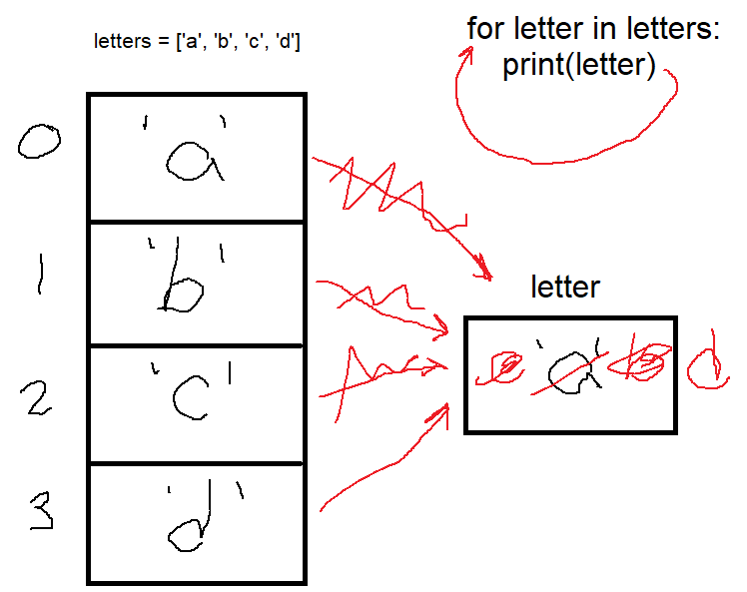
for loop

Slide 6
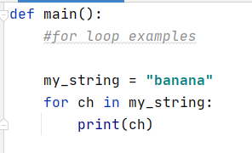

for loop
Using a for loop with a string: Output:

Slide 7
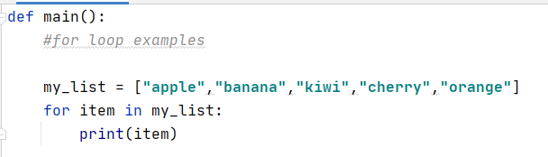
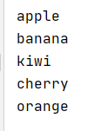
for loop
Using for loop with a list: Output

Slide 8
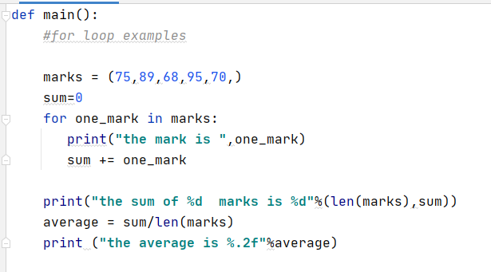
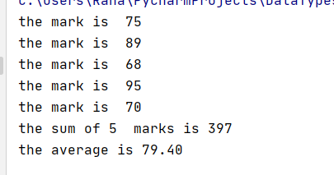
for loop
Using for loop with a tuple: Output:

Slide 9
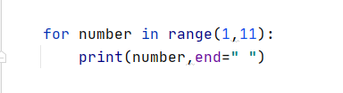

for loop
Using for loop with a range
Example: Output:

Slide 10
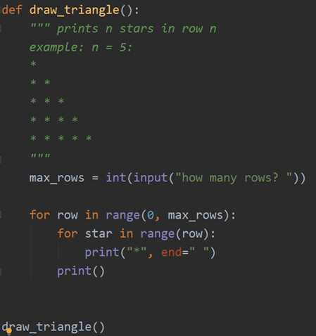
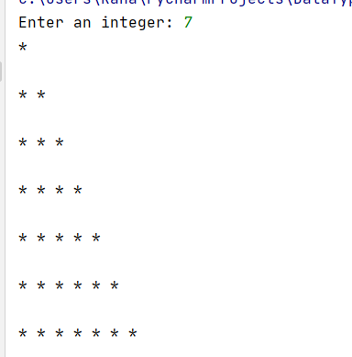
nested loops
A nested loop is a loop that appears in the body of another loop (outer loop and inner loop)
Example: Output:

Slide 11
nested loops
Nested loops can be used with lists of lists.
cars = ["dodge", "volvo", "lamborghini"]
cities = ["vancouver", "los angeles"]
countries = ["canada", "united states of america", "france", "china", "russia"]
stuff = [cars, cities, countries]
# use for loops to print out all ten strings in stuff
for one_list in stuff: # first loop, one_list is ["dodge", "volvo", "lamborghini"]
for item in one_list:
print(item)
print("------")

Slide 12
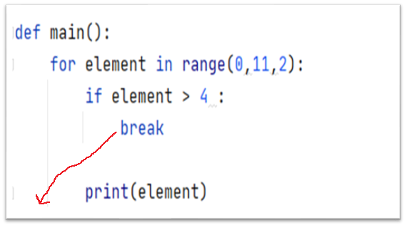
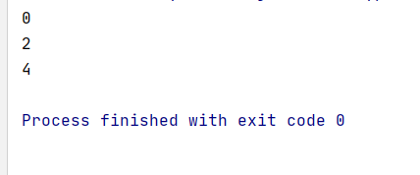
break statement
break can be used to terminate any loop prematurely.
Example: Output:

Slide 13
break statement
break can be very useful:
found = False
names = ["a", "b", "c", "d", "e", "f", "g"] # imagine a million names...
for name in names:
if name == "c": # we are looking for "c"; if we find it, stop looking!!!
print("FOUND IT!")
found = True
break
if not found:
print("NOT FOUND")

Slide 14
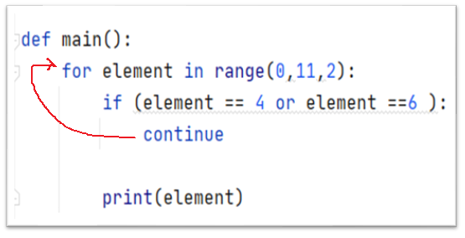

continue statement
continue is used to immediately stop the rest of the current iteration and asks if it should continue to the next iteration.
Example: Output:

Slide 15
Stopping things
pass code that does nothing at all in a function
break ends a loop immediately
continue immediately jumps to the condition at the top of a loop, to ask “should I continue?”
return ends a function immediately
exit ends the program (don’t do this)

Slide 16
enumeration: get index and value in for loop
cities = ['vancouver', 'calgary', 'victoria', 'burnaby', 'edmonton’]
for city in cities:
print(city) # note: do not reference the cities container inside the loop
for index, city in enumerate(cities):
print("index is %d for %s" % (index, city)) # index is 0 for Vancouver, etc….

